Slide 1
Controlling branding in SharePoint using app model
Name
Title
Company

Slide 2
Agenda
Introduction
Themes and other branding techniques
Controlling publishing capabilities
Updating existing sites

Slide 3















Vision
EXTEND OFFICE EVERYWHERE
CONNECT TO OFFICE 365 SERVICES
BUILD USING AN OPEN PLATFORM
Delve
z
Users and groups
Files
Mail
Calendar
My Apps
Video Portal
Contacts
Office Graph
Presentations
Documents
Spreadsheets
Lync
OneNote
Yammer

Slide 4
Recommendations
Avoid custom master pages
Use Office 365 themes when possible
Consider using Alternate CSS
Themes can be used to control color and fonts
Notes:
Vesa

Slide 5
“You do not brand Outlook or Word, why do you need to do branding on collaboration sites?”
Good question…
Applying branding is absolutely supported and understandable for intranet portals, but what about collaboration sites? It is recommended to consider the cost versus gain

Slide 6
Introduction
Notes:
Controlling branding, recommendations, patterns for app model

Slide 7

How to minimize future maintenance?
Use themes rather than master pages
All changes to OOB master pages are provided to your sites automatically without need to modify custom code
Avoid feature framework element usage
Many feature framework elements will create dependency to xml files on the disk , which then cannot be removed easily (think “Content Migration”)
Sandbox solutions will also impact future cost model of the Office365 sites
Notes:
Vesa

Slide 8
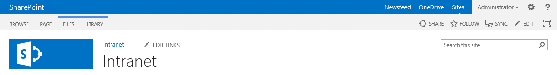
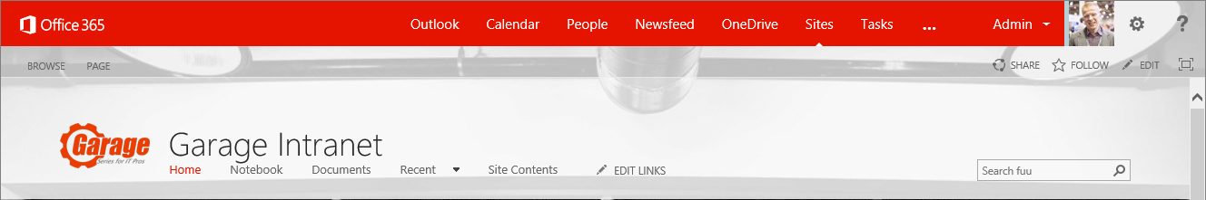
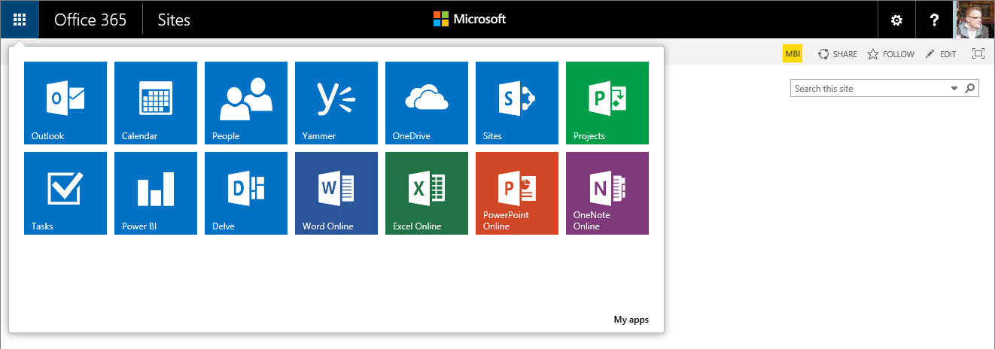
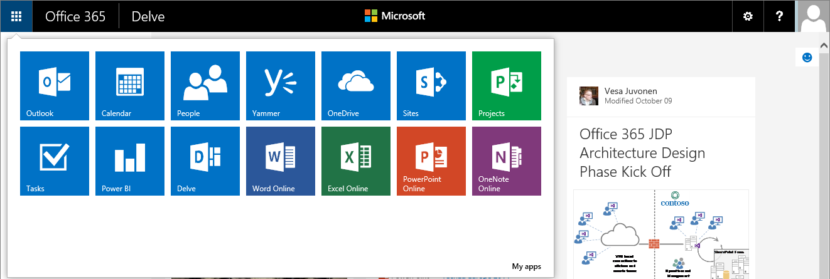
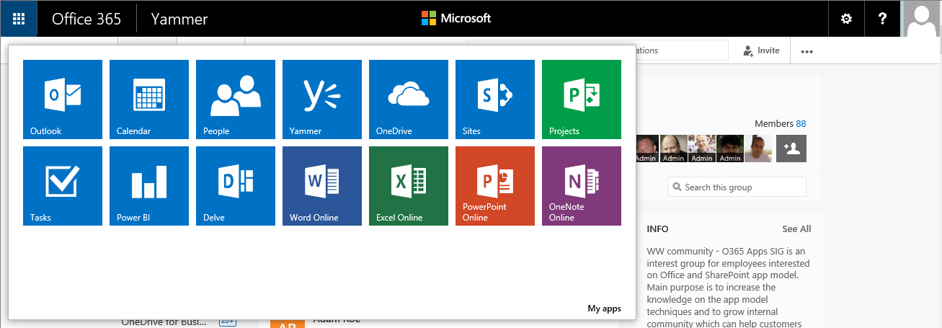
Example: Custom master page and case of an evolving suite bar…
Notes:
Vesa Great Slide to explain the methodology and thinking behind why we want to discourage these EXC

Slide 9
What is the challenge with custom master page?
New custom master page is created by copying oob master or starting from scratch using oob master as the reference
Significant differences on the outcome unless custom master page been updated during the releases.
contoso.master
contoso.master
contoso.master
master
Version 1.0
master
Version 1.0
master
Version 1.0
<< Copy >>
Custom Master
Oob Master
Seattle.master
Seattle.master
Seattle.master
master
Version 1.0
master
Version 2.0
master
Version 3.0
Time
Service updates for introducing new version of the out of the box master page with some new capabilities or bug fixes.
Notes:
Vesa
Risk is that for sites created from the time WE updated the service until the time YOU updated your Templates, these sites will NOT have all of the features

Slide 10
“But I have always customized my sites with custom master, what has changed?”
Nothing
Actually this similar maintenance challenge exists in on-premises and across the version upgrades as well. Concentrate on what’s truly needed.
Notes:
Vesa

Slide 11
“How should I get my files uploaded to the SharePoint sites? Using sandbox?”
No.
It is recommended to upload files as part of the site provisioning process remotely using so called “remote provisioning” pattern directly using remote APIs.
Notes:
Vesa

Slide 12
“I have an intranet portal and I need to do heavy branding customizations!”
Absolutely fine.
Key point is to understand the impact of the chosen pattern. Custom master pages are completely supported, you might want to use alternative approaches if possible.
Notes:
Vesa

Slide 13
Themes

Slide 14

Themes
What
Provide user branding elements without introducing master page or page layout elements
Why
Continue using out of the box master pages, but introduce customer specific branding elements
How
Use theming engine for introducing color, fonts and background images for sites
Notes:
Steve

Slide 15
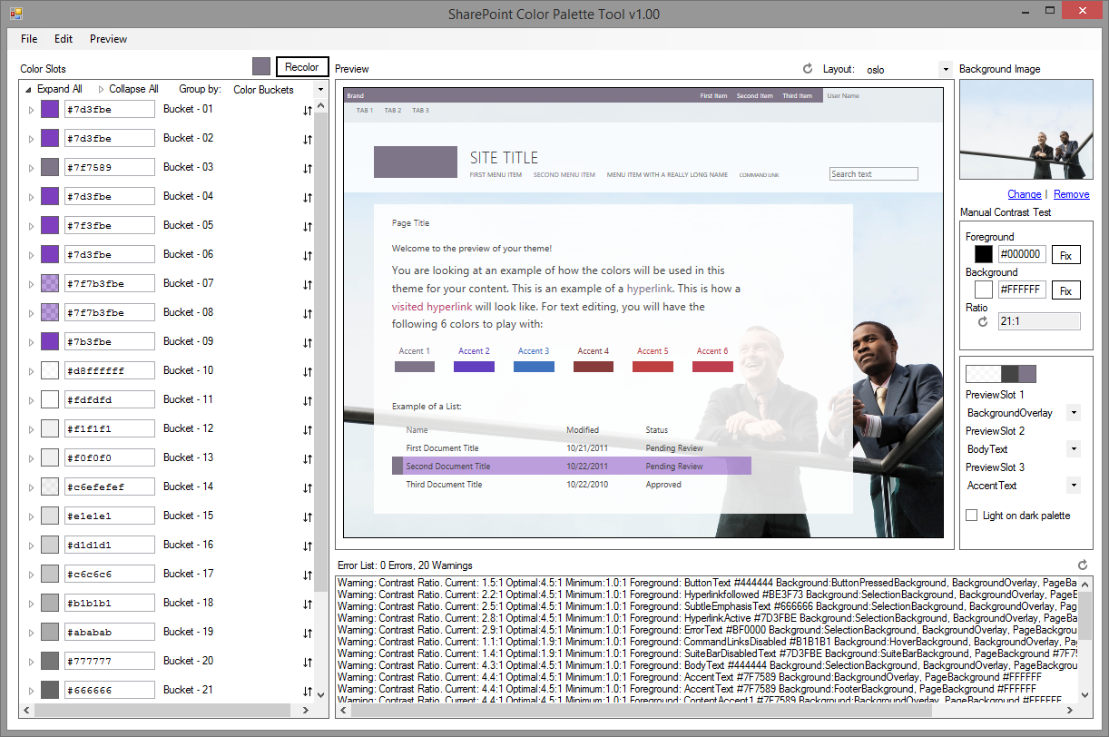
SharePoint Color Palette Tool v1.00
Free downloadable tool to create custom themes based on branding requirements from Microsoft download site
Can be used to create themes in matter of minutes with company colors and images
Notes:
http://www.microsoft.com/en-us/download/confirmation.aspx?id=38182
Steve

Slide 16
Use themes rather than custom master pages
Themes are more future friendly than custom master pages…
Why?
Notes:
Steve

Slide 17
Theme vs. master page
Theme
Can be introduce to bring color, font and background image settings
Sites with themes will still use out of the box master pages, so any updates will be automatically impacted to sites
Future major version upgrades don’t cause additional costs
Custom Master Page
Can introduce any level of customizations
When new changes are introduced to the out of the box master, those should be copied to custom master pages as well
Additional maintenance burden
Future major version upgrades can cause additional requirements to re-create the end user experience

Slide 18
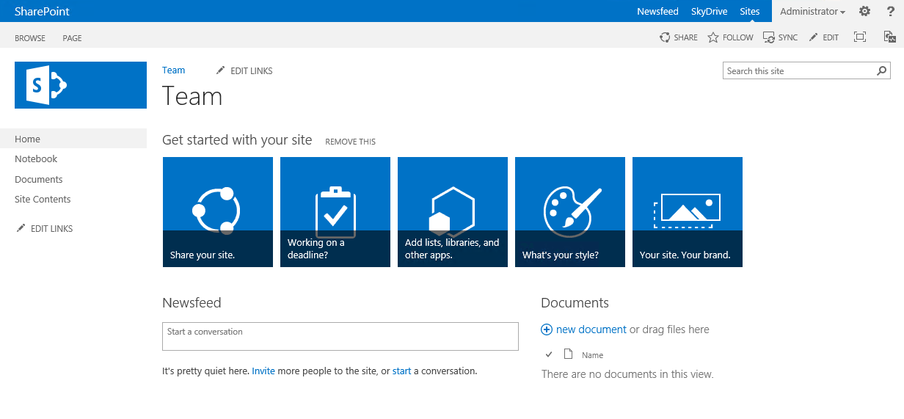
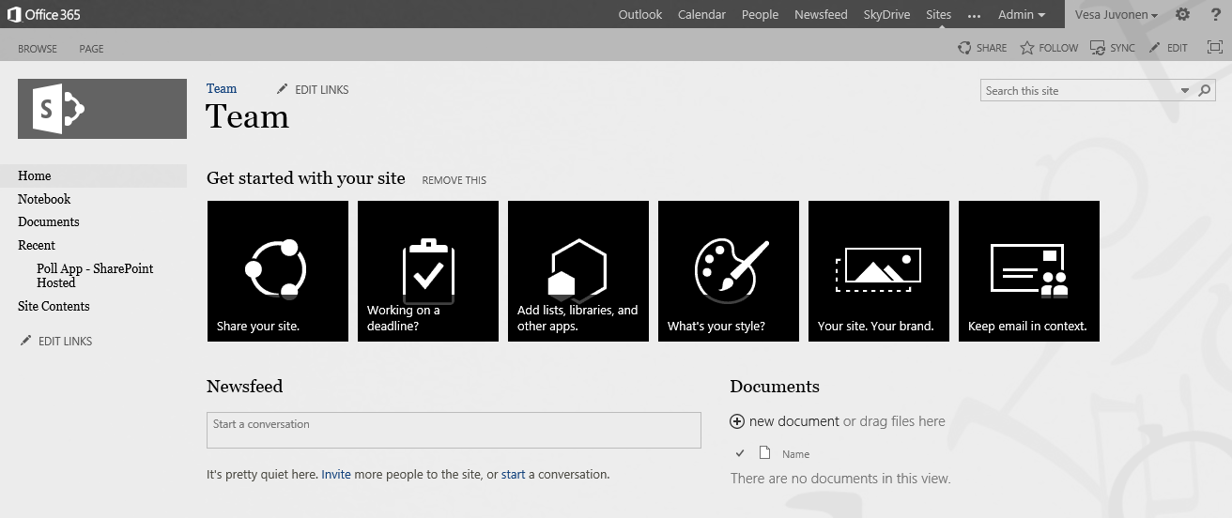
Handling themes from SP Apps
1
Provider Hosted Apps
SharePoint Service
CSOM
3
Upload needed files
Set theme to site
(Set master page to site)
Theme elements
2
Color file
Font file
Background image
(Master page)
Notes:
Steve App is started from the web by end user or process is started during provisioning
App side has the needed theme elements and other assets for sites, which will be published
App drives the modification of the host web by applying the needed customizations to host web

Slide 19
Using themes for branding
Demo
https://github.com/OfficeDev/PnP/tree/master/Scenarios/Branding.Themes

Slide 20
Office 365 Themes

Slide 21
Office 365 Themes
What
Control branding settings across different Office 365 services, but not Sites (SharePoint)
Why
Provide branding consistency across all services, like Yammer, Delve or OneDrive for Business
How
You can control company wide default branding settings from the Office 365 administration services
SharePoint sites use Office 365 if site specific theme is not applied
Personal theming option can be disabled by tenant administrator, if needed
Notes:
vesa

Slide 22
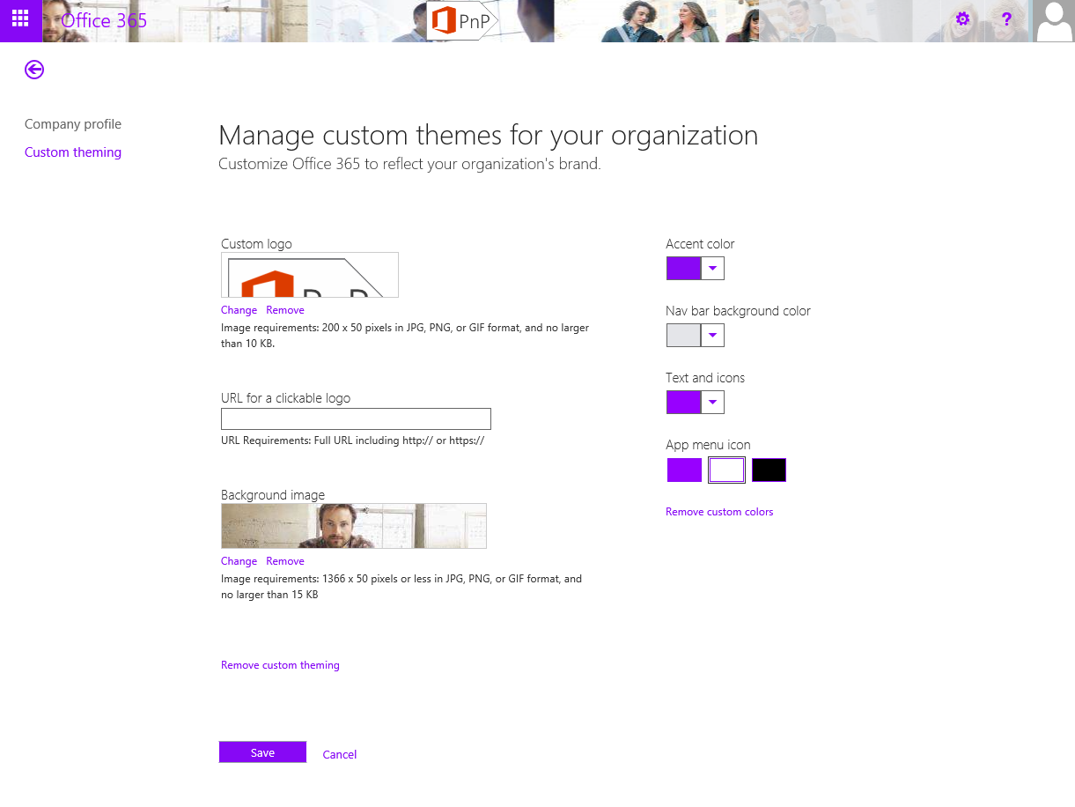
Controlling themes for Office 365
Notes:
vesa

Slide 23
Office 365 themes
Demo

Slide 24
Alternate CSS

Slide 25
Adding alternative styling for host web
What
Provide alternate CSS styling elements to the web by adding custom style elements to the page rendering process
Why
To provide more comprehensive changes on the page layout compared to what themes can do without introducing a custom master page
How
Use the AlternateCSSUrl web object property, which was introduced as new capability in the 2014 April CU for SharePoint 2013
Notes:
Vesa

Slide 26
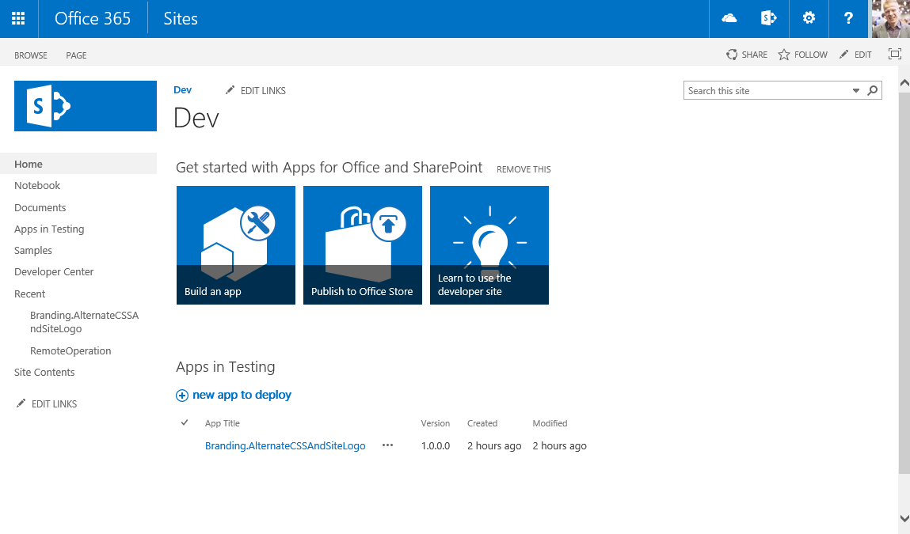
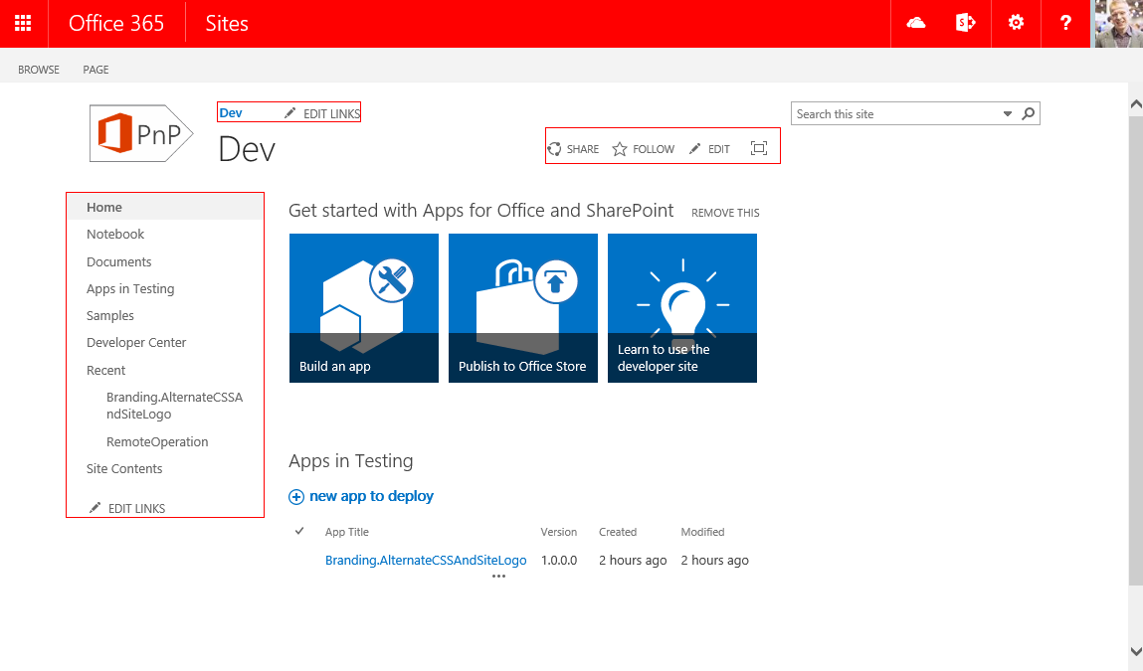
Controlling CSS from App
1
Provider Hosted Apps
SharePoint Service
CSOM/REST
3
Upload CSS
Set alternate CSS for the site
Assets
2
CSS file
Images
Notes:
Steve App is started from the web by end user or process is started during provisioning
App side has the needed theme elements and other assets for sites, which will be published
App drives the modification of the host web by applying the needed customizations to host web

Slide 27
Using custom css and custom logo
Demo
https://github.com/OfficeDev/PnP/tree/master/Samples/Branding.AlternateCSSAndSiteLogo

Slide 28
Branding with publishing sites

Slide 29
Recommendations for master page
IF you should choose that Master Pages are right for you, AND you are ok with the ongoing potential maintenance… THEN
Minimize your changes compared to out of the box master pages
Change only what is needed in the master and combine to themes and possibly alternate CSS option for easier maintenance
Deploy master pages directly using remote API rather than using sandbox solutions
Design packages are also Sandbox solutions
Notes:
Steve

Slide 30
Controlling master page and page layouts from app
1
Provider Hosted Apps
SharePoint Service
CSOM/REST
3
Upload master page
Upload page layouts
Set site master page using CSOM
Set page layouts
Set allowed site templates
Branding assets
2

Slide 31
Branding and publishing sites
Demo
https://github.com/OfficeDev/PnP/tree/master/Scenarios/Provisioning.PublishingFeatures

Slide 32
Summary on branding options

Slide 33


Branding options for SharePoint sites
Office 365 Themes
Theme
Alternate CSS
Custom Master Page
Can be used to centrally control branding cross all services in the Office 365
Limited settings currently
Can be overridden in site level
Only in Office 365, not in on-premises
Can be used to control branding, fonts and background image of the sites
Configuration applied to each site
Can be used to override whatever CSS settings
Control to color, fonts and even layout settings
Configuration applied to each site
Full control on how the site is rendered
Applied to each site, except for publishing sites
Any updates to oob master pages are not automatically reflected on the sites
Options
Support
only
Flexibility
Fair
Average
Good
Unlimited
Cost impact (short and long term)
Notes:
Vesa & Steve Dialog

Slide 34
Branding options
Notes:
Vesa & Steve Dialog

Slide 35
Updating branding on existing sites

Slide 36
Updating Branding on existing sites
What
Update branding and other settings in the sites after they are created based on new requirements
Why
It’s common that there have to be some adjustment done to the sites, that have been previously created
How
Provision shared static elements like images, CSS files, and JavaScript files to one location and reference them from sites as needed with relative path
Elements which has to be stored in site collection level can be updated by looping through the sites and update them one by one using remote provisioning model without downtime
Notes:
Vesa

Slide 37
“So I would have to loop through all sites and update stuff one by one?”
Yes.
This can take a while with thousands of sites, but there’s no down time for doing this. You can also pinpoint specific sites to be updated first if needed.
Notes:
NOTE: How did you do it before with Farm Solutions ?????
Vesa

Slide 38


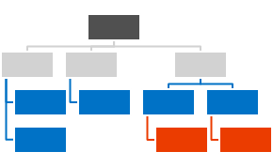
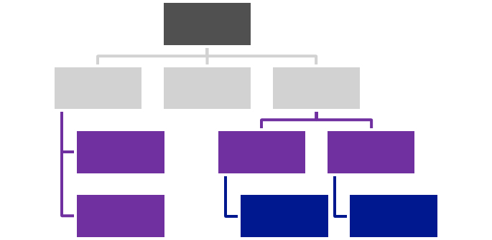



Centralized Asset Deployment
https://Contoso.sharepoint.com /sites/site
https://Contoso.sharepoint.com
<<Reference>>
https://Contoso.sharepoint.com /sites/site2
<<Reference>>
<<Reference>>
<<Reference>>
Provider Hosted App
<<Reference>>
https://Contoso.sharepoint.com /sites/site3
<<Reference>>
Notes:
Vesa Static assets like images, JS files, and CSS files are deployed together with the master page and asp files to the root site collection of the a web application or a tenant.
Dynamic files like master pages and other asp pages are deployed to the each site collections.
Static files are referenced from the root site collection using relative links.
Provides one location to change most of the functionalities and there’s no need to deploy all the image, CSS, or JS files to each of the site collection.

Slide 39
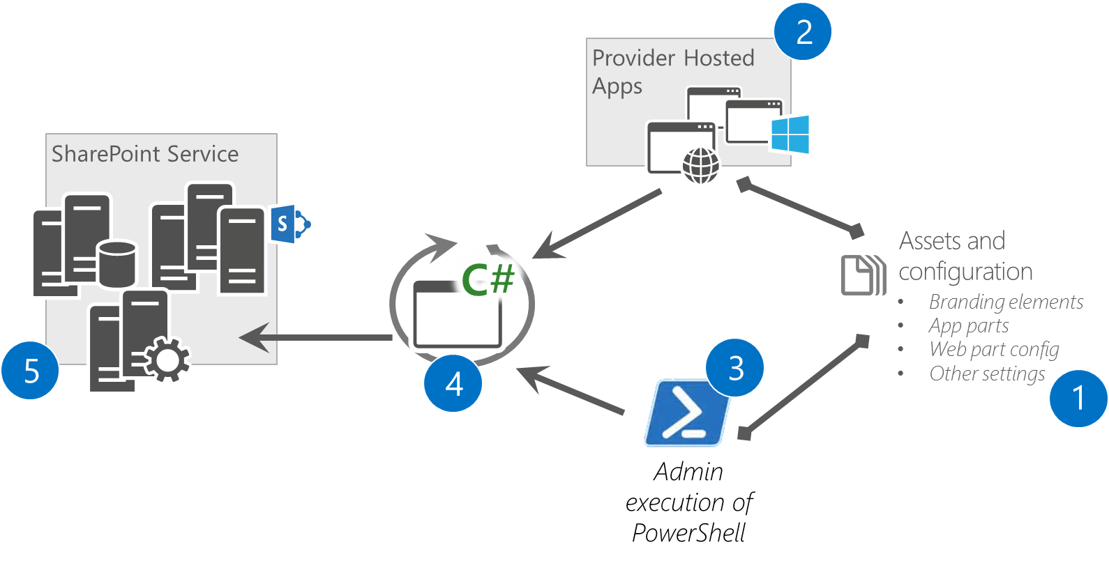
Updating Branding Afterwards Reference architecture for branding management
Implement branding controlling logic to a reusable component, which can be called from the app and from other solutions
Provides reusability and easy maintenance
Could also be PowerShell scripts
Notes:
Vesa

Slide 40
Recommendations
Avoid custom master pages
Use Office 365 themes when possible
Consider using Alternate CSS
Themes can be used to control color and fonts
Notes:
Vesa

Slide 41
Questions?

Slide 42

aka.ms/OfficeDevPnP
Transform your code
Providing App Model Patterns for common scenarios Open source and based on community contributions Constantly evolving set of material for reuse
100+ Visual Studio projects
Common scenarios Branding Site provisioning Remote event receivers
UX component Taxonomy driven navigation And much more…
Patterns and Practices Yammer Group - http://aka.ms/officedevpnpYammer

Slide 43
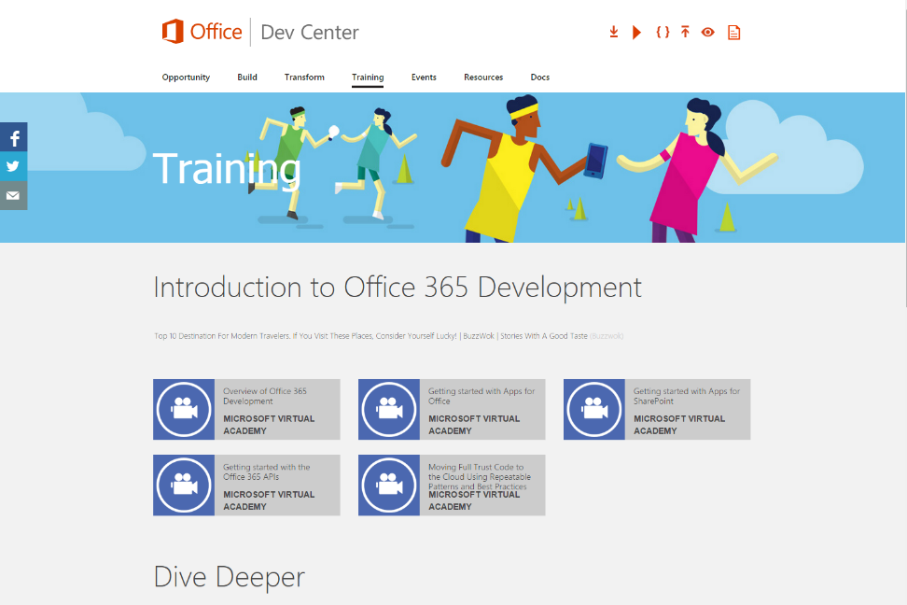
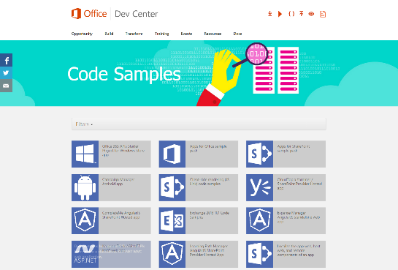
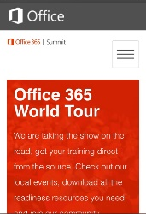
dev.office.com
Sign up
http://dev.office.com/getting-started
Explore
http://apisandbox.msdn.microsoft.com
Get trained http://dev.office.com/training

Slide 44


Feedback
Office 365 Network Share you best practices and join conversations
https://www.yammer.com/itpronetwork
Stackoverflow Ask deep technical questions to a world-wide set of developers
http://stackoverflow.com/questions/tagged/ms-office
UserVoice Provide suggestions of what you want in future versions
http://officespdev.uservoice.com/

Slide 45


© 2015 Microsoft Corporation. All rights reserved. Microsoft, Windows, and other product names are or may be registered trademarks and/or trademarks in the U.S. and/or other countries.
The information herein is for informational purposes only and represents the current view of Microsoft Corporation as of the date of this presentation. Because Microsoft must respond to changing market conditions, it should not be interpreted to be a commitment on the part of Microsoft, and Microsoft cannot guarantee the accuracy of any information provided after the date of this presentation. MICROSOFT MAKES NO WARRANTIES, EXPRESS, IMPLIED OR STATUTORY, AS TO THE INFORMATION IN THIS PRESENTATION.

